Slide 1
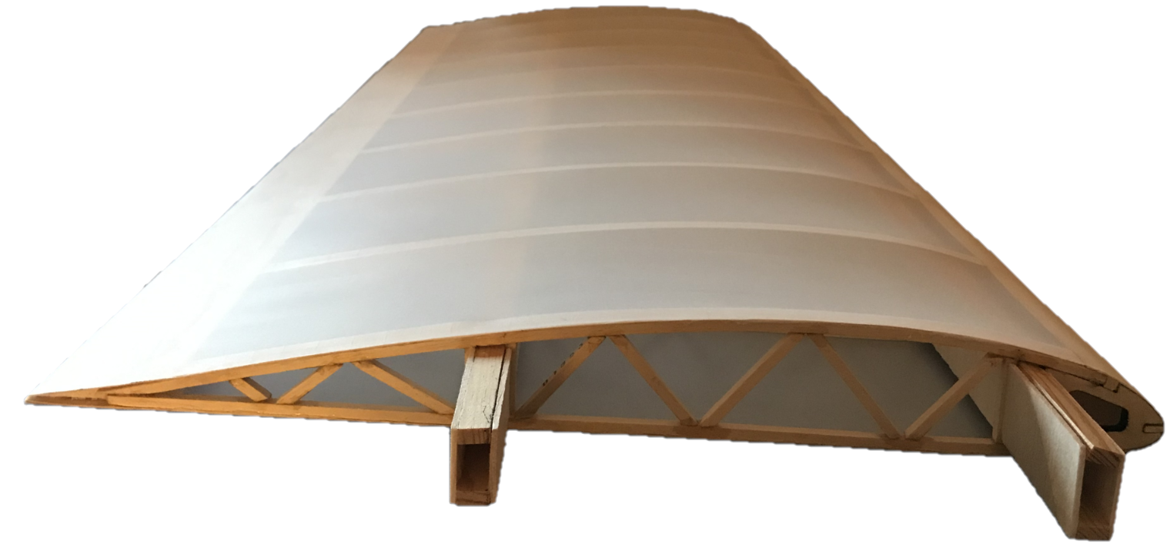
Wing Experimentation and Simulation
CLARK-Y and NACA-0010 Aerofoil
Jalendu Africawala
Emmanuelle Fried
Daniel Opoka

Slide 2
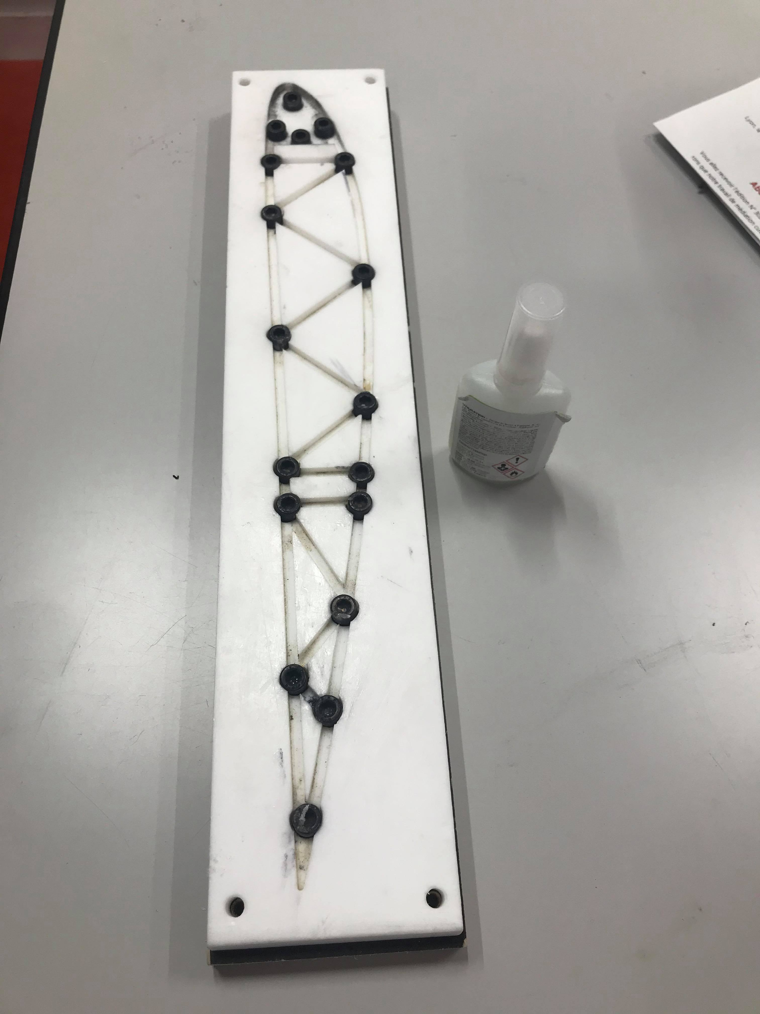
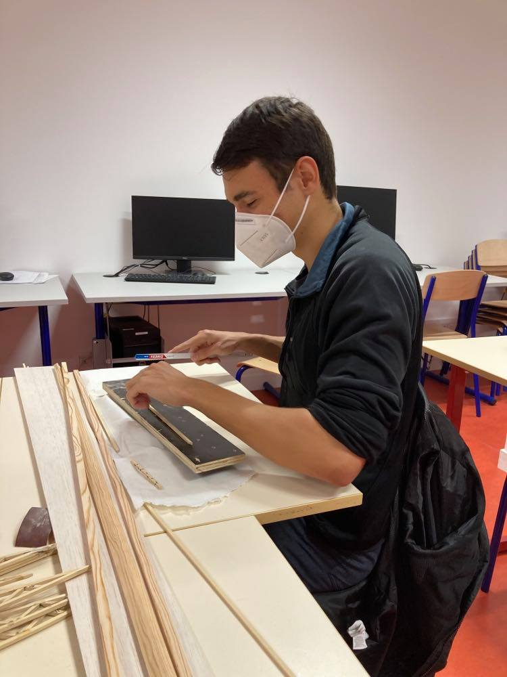
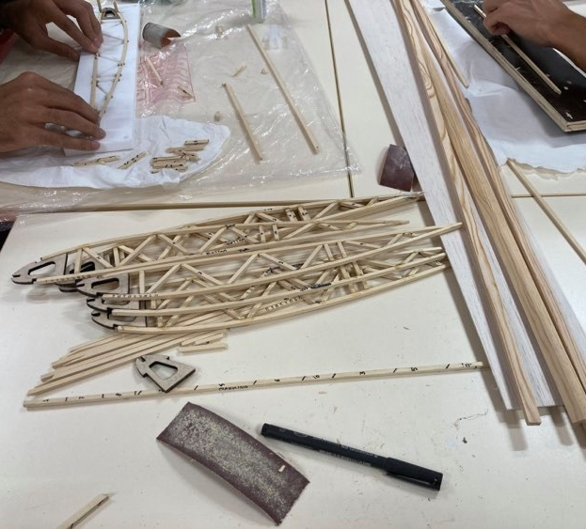
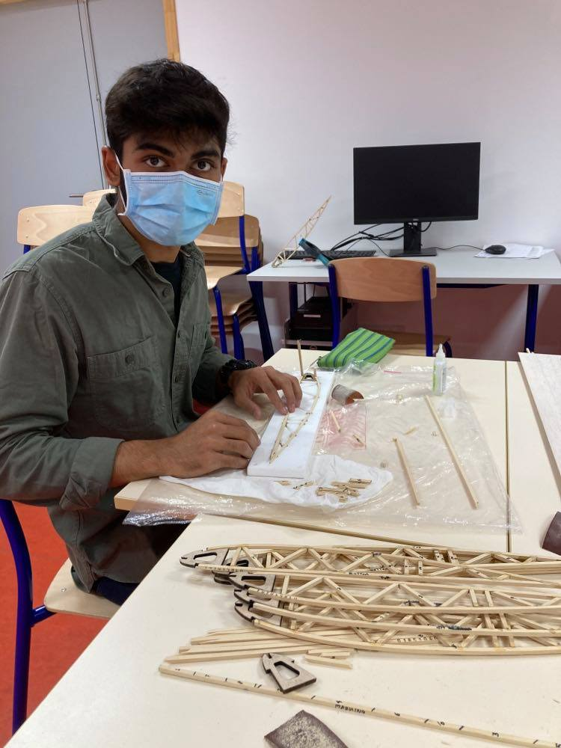
Rib Building Process
Using mold, measure standard stick
Measure out individual parts
Cut
Glue
Remarks
Fast
Sometimes inaccurate—had to recut

Slide 3
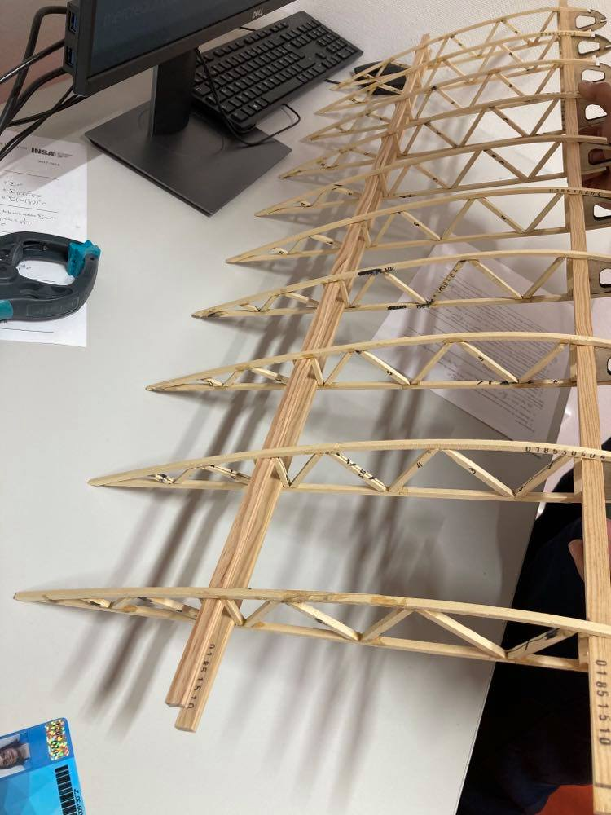
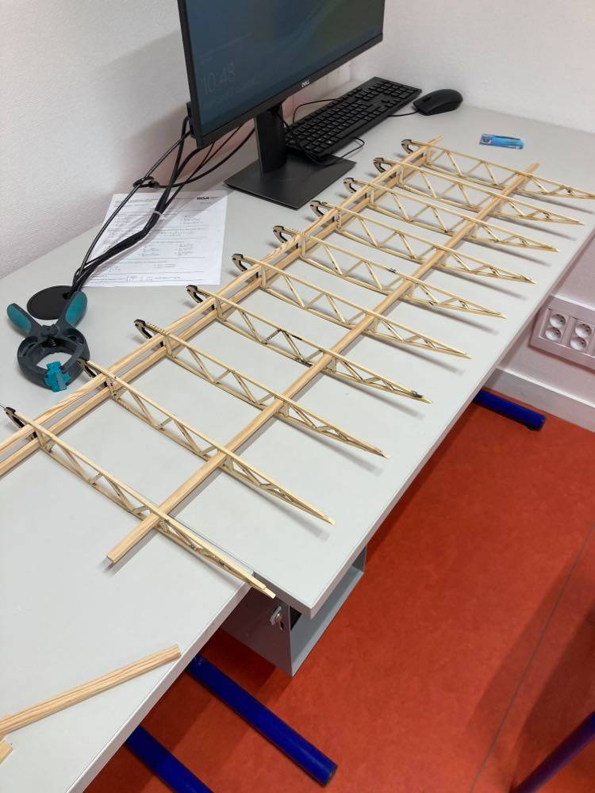
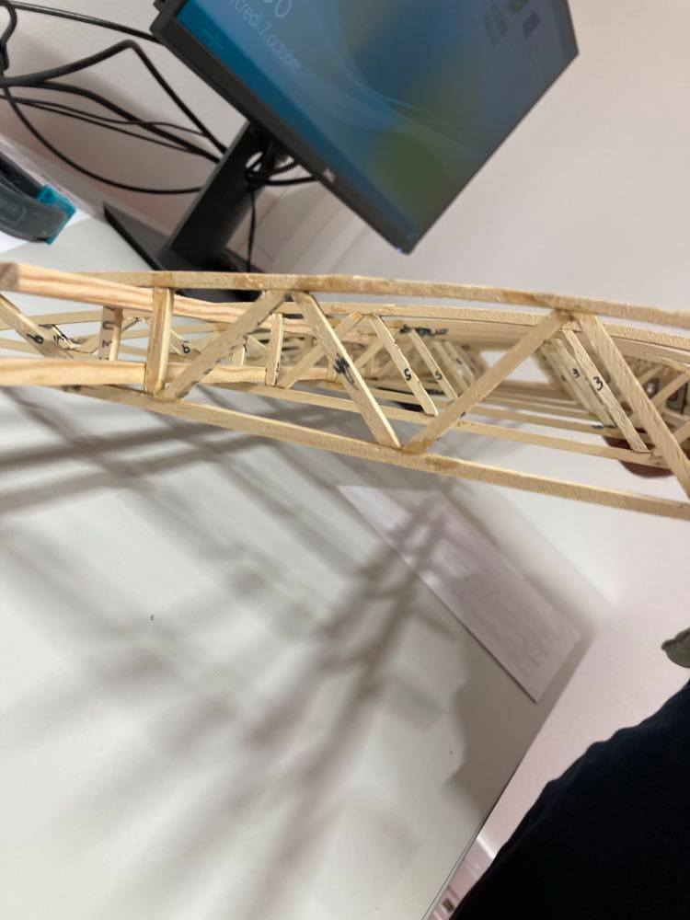
Adding Spars
Threaded spars vertically
Twisted to align horizontally
Top and bottom spars for front and back
Required strength!

Slide 4
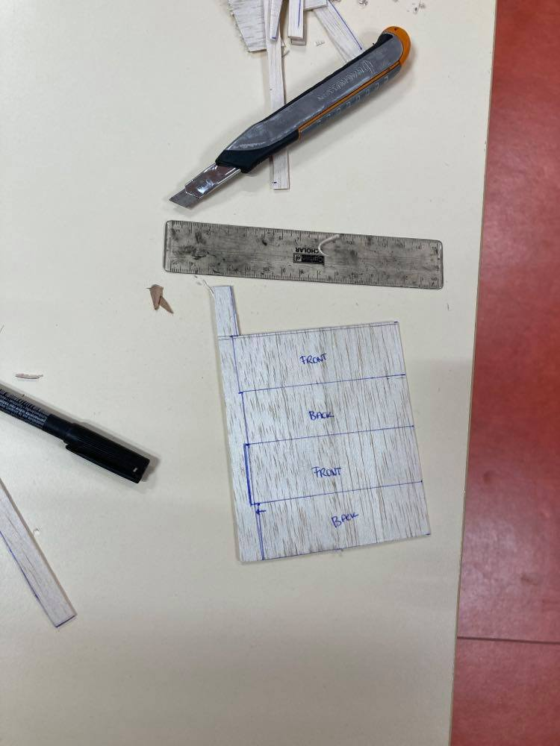
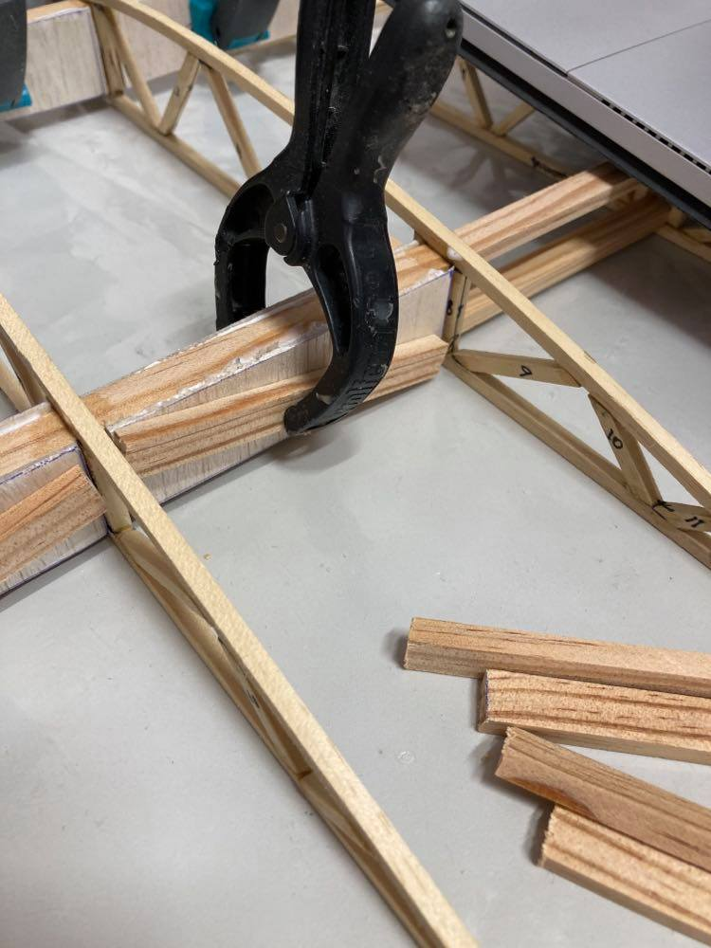
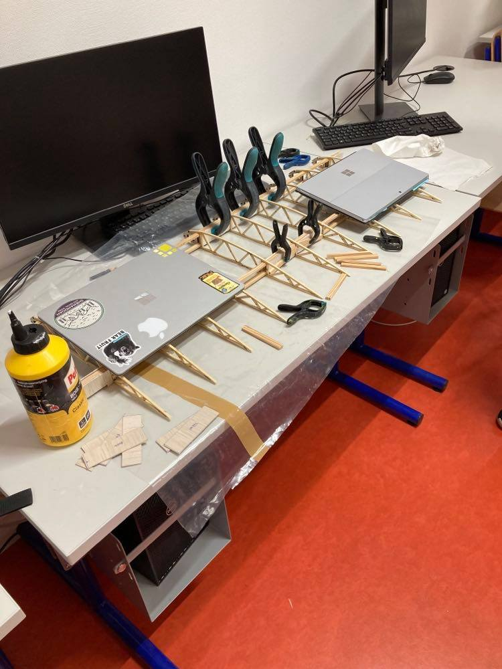
Webbing with balsa
Webbing cutout
Webbing placement
Repeat

Slide 5
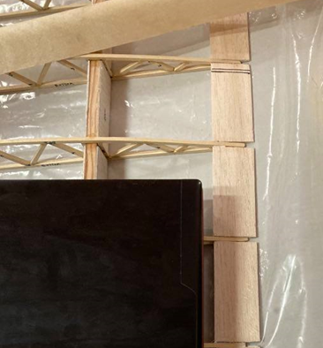
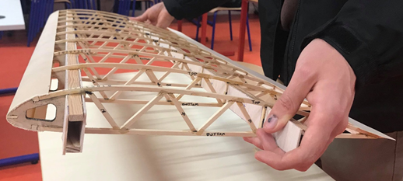
Adding covers at the leading and trailing edge
Leading edge
Trailing edge

Slide 6
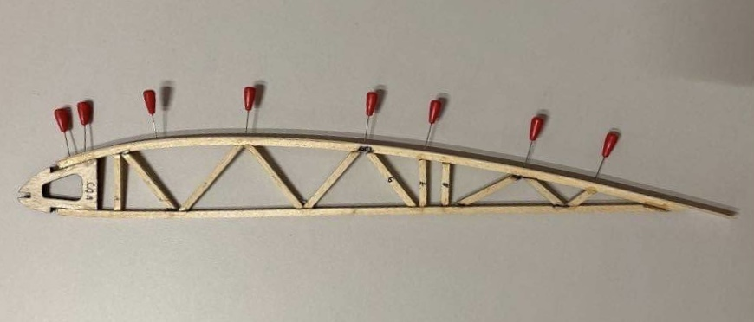
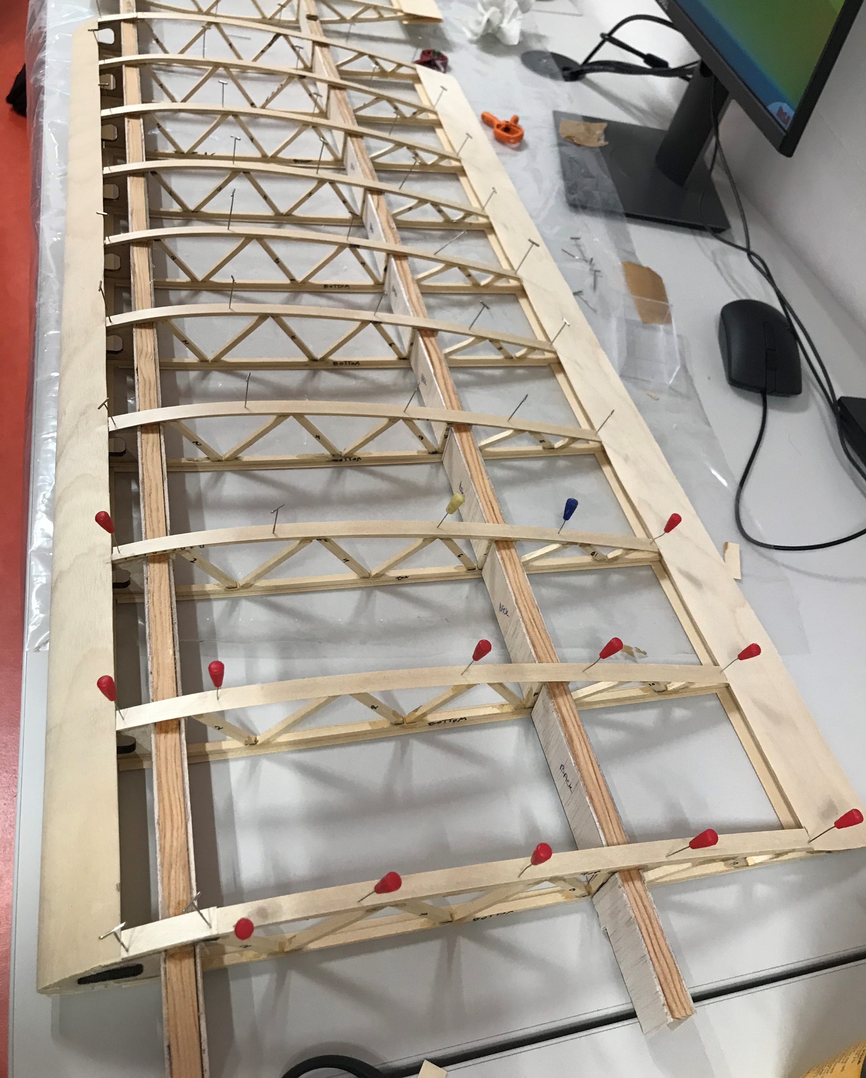
Attaching cap strips to the ribs
Plywood cap strips
Added to the torsional and bending stiffness
Aid in supporting the skin

Slide 7
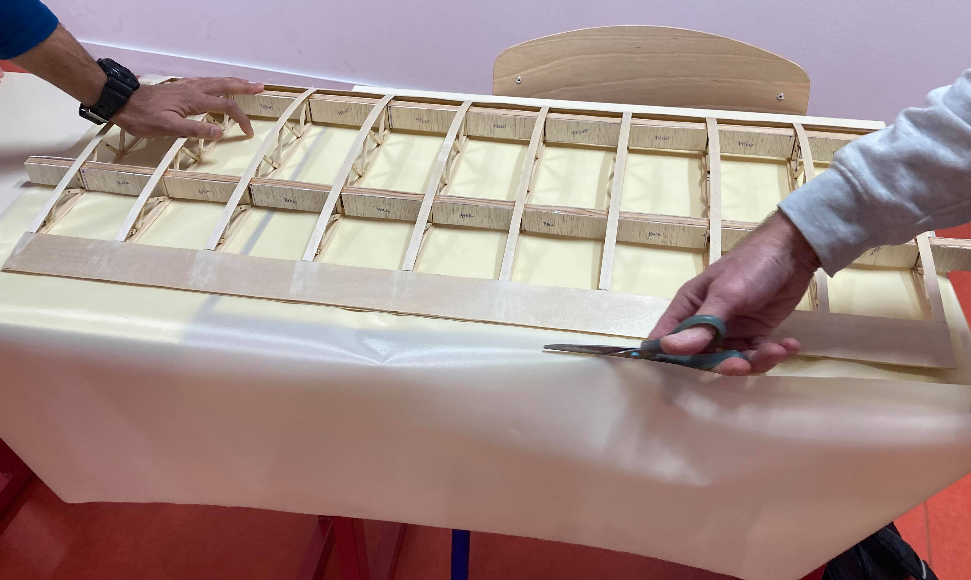
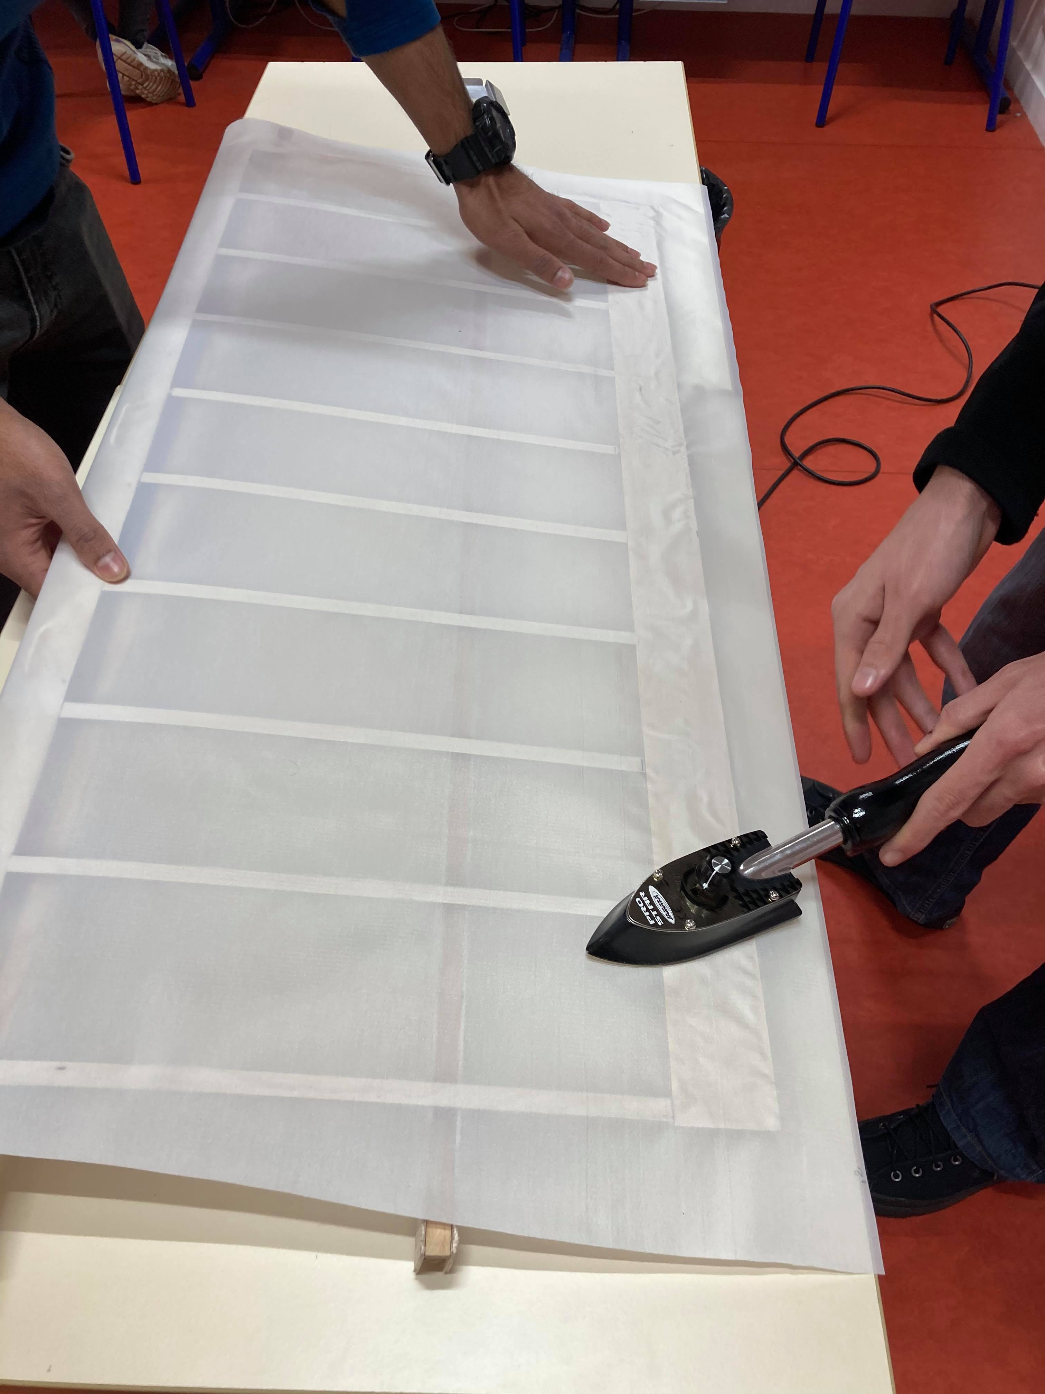
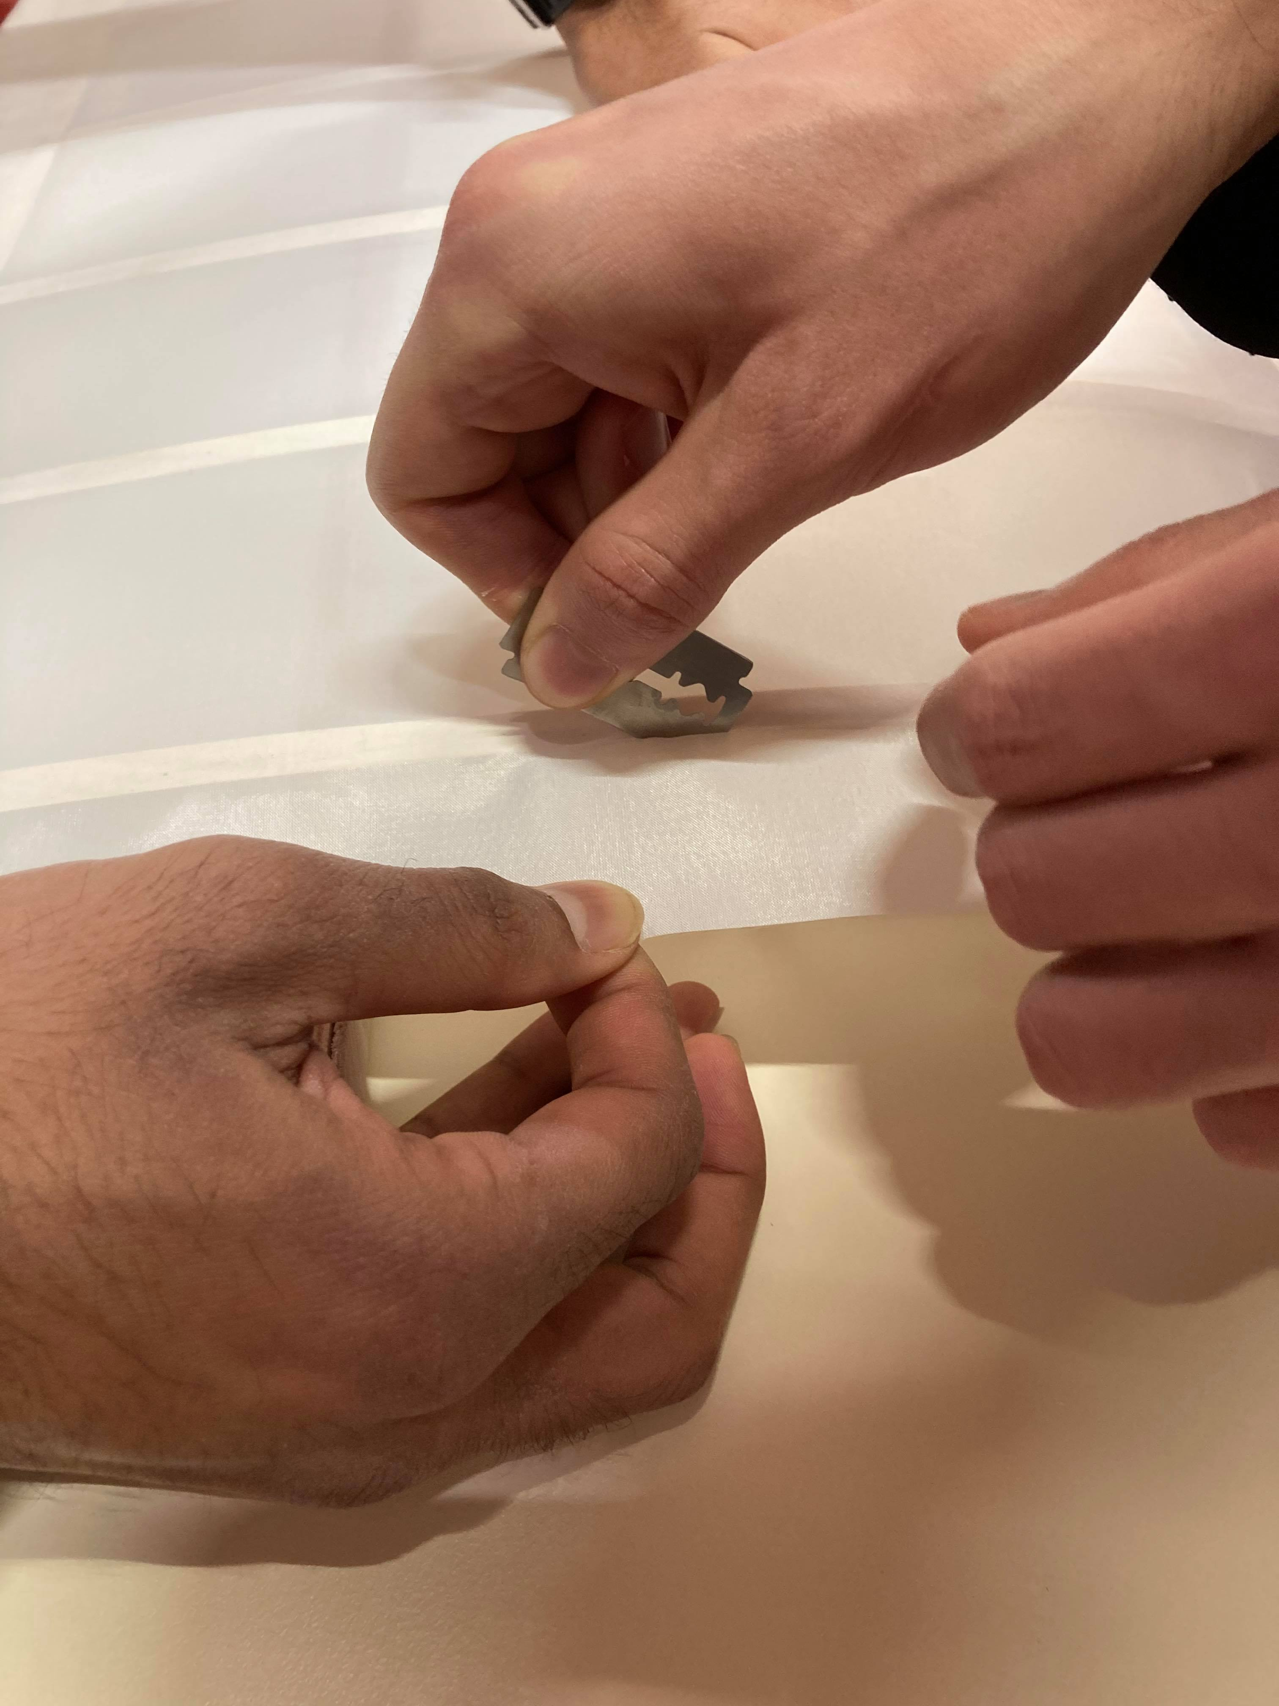
Covering the wing with skin
Cutting the nylon to size
Considerable amount of wastage
Fibres aligned parallel to the ribs
Iron
Cut the edges
Overlap top over bottom skin

Slide 8
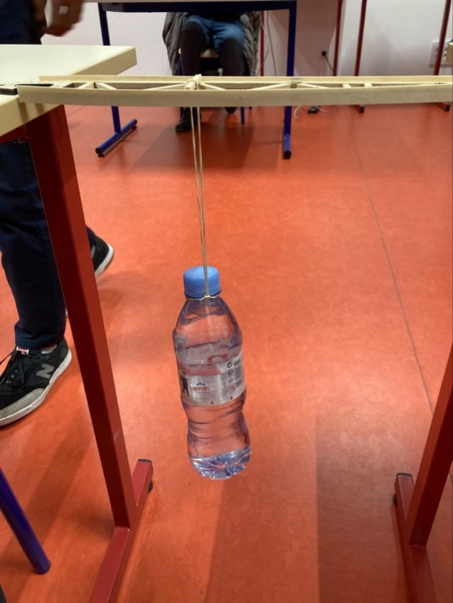
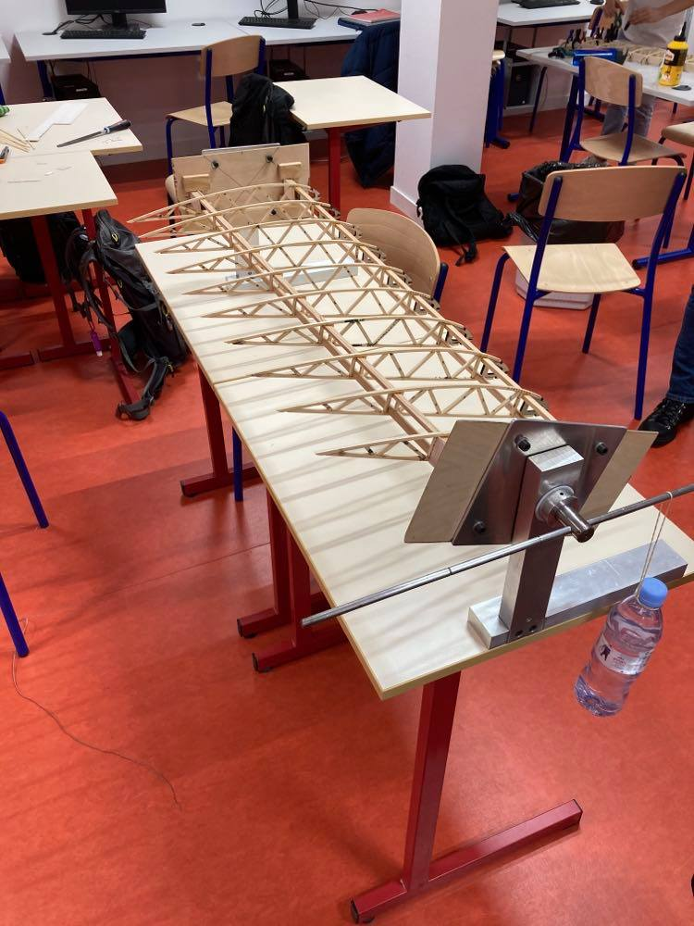
Measurements
Bending Stiffness
Torsional Stiffness

Slide 9

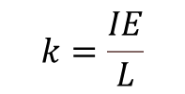
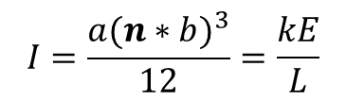
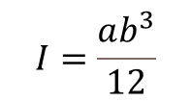
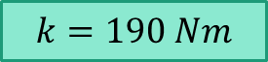
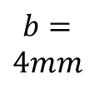
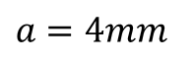
Bending Stiffness and Comparison to individual beams
For one beam…
$$I=\frac{ab^{3}}{12}$$
$$k=\frac{IE}{L}$$
 | Weight (in N) | Deflection (in cm) | Rib stiffness K (Nm) | Equivalent number of beams, side by side | Equivalent number of beams, stacked vertically
Without Cap-strip | 4.905 | 1.2 | 408.75 | 2.1475 | 1.2902
With Cap-strip | 9.81 | 0.4 | 2452.5 | 12.8847 | 2.3444
$$k=190 Nm$$
$$k=\frac{P}{w}$$
$$b=$$
$$4mm$$
$a$ $=4mm$
For vertical equivalence…
$$I=\frac{a{(n∗b)}^{3}}{12}=\frac{kE}{L}$$

Slide 10
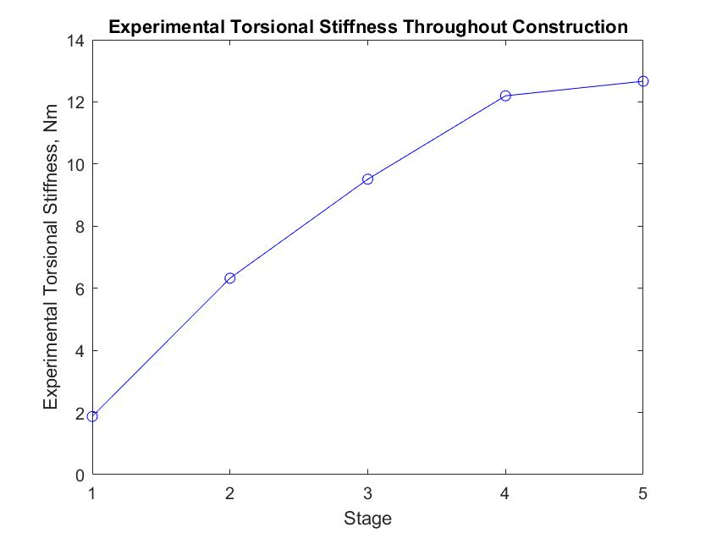
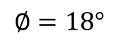
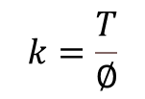
Torsional Stiffness
Stage of Construction | Moment (in Nm)
1st: Ribs connected by spruce bars | 0.5886
2nd: Balsa webbing | 1.9865
3rd: Plywood on LE and TE | 2.9879
4th: Cap strips on ribs | 3.8308
5th: Skin | 3.9780
Torsional stiffness (in Nm)
1.8736
6.3233
9.5106
12.196
12.664
$$∅=18°$$
$$k=\frac{T}{∅}$$

Slide 11

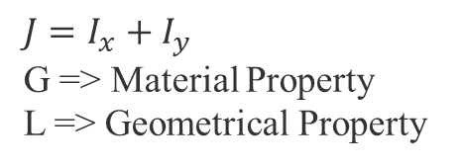
Analysis: Comparison to Mathematical Model
Analytical Torsional Stiffness:
Stage | Analytical Torsional Stiffness | Experimental Torsional Stiffness | Percent Error between Analytical and Torsional Stiffness
1st | 2.255 | 1.8736 | 16.9%
2nd | 6.912 | 6.3233 | 8.52%
3rd, TE ignored | 13.067 | 9.5106 | 27.21%
4th | ---- | 12.196 | ----
5th | ---- | 12.664 | ----
$$k=\frac{JG}{L}$$
$$J=I_{x}+I_{y}$$
G => Material Property
L => Geometrical Property

Slide 12
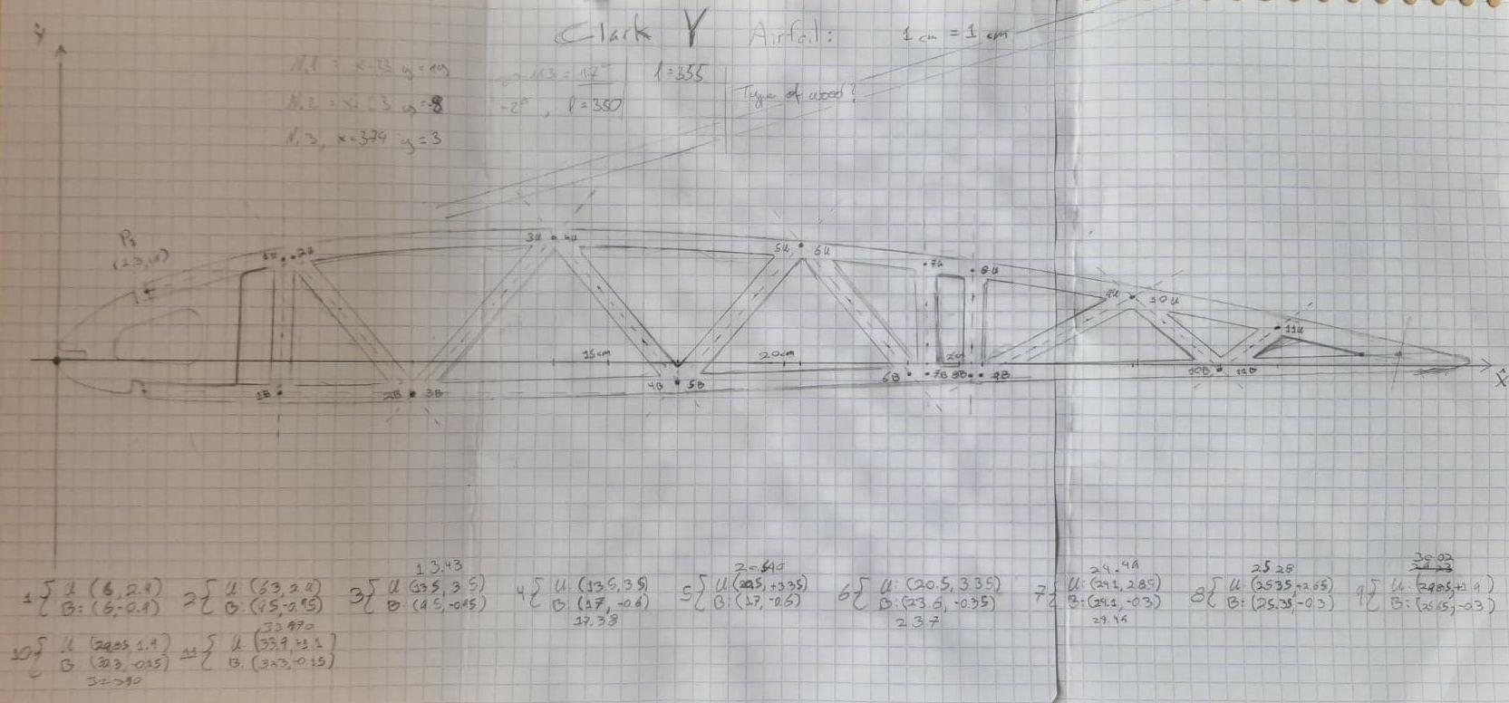
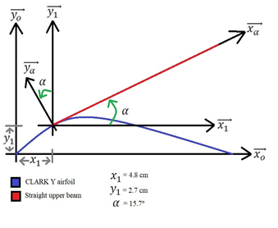
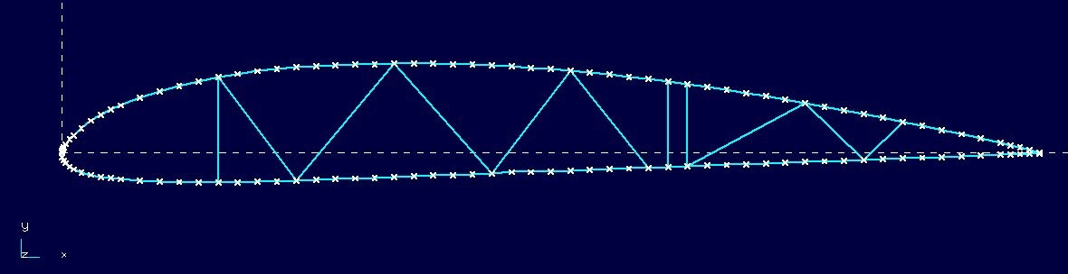
RDM6 study of wing rib

Slide 13
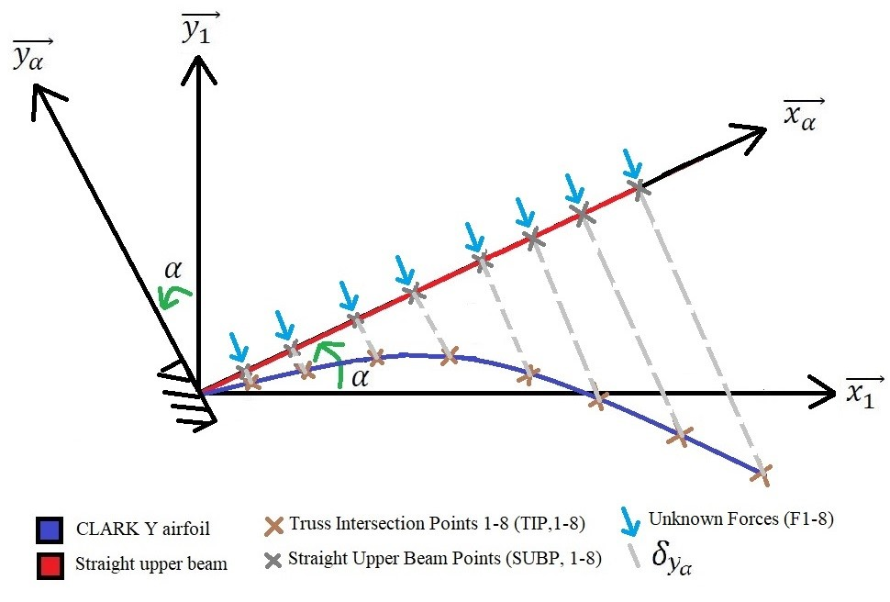
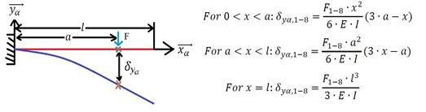
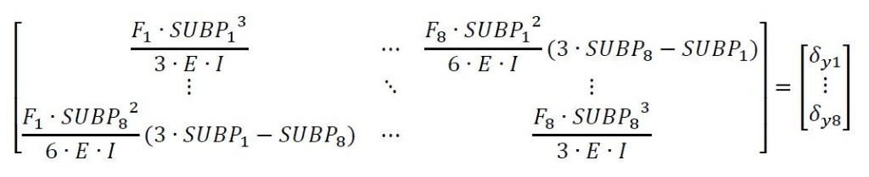


Slide 14
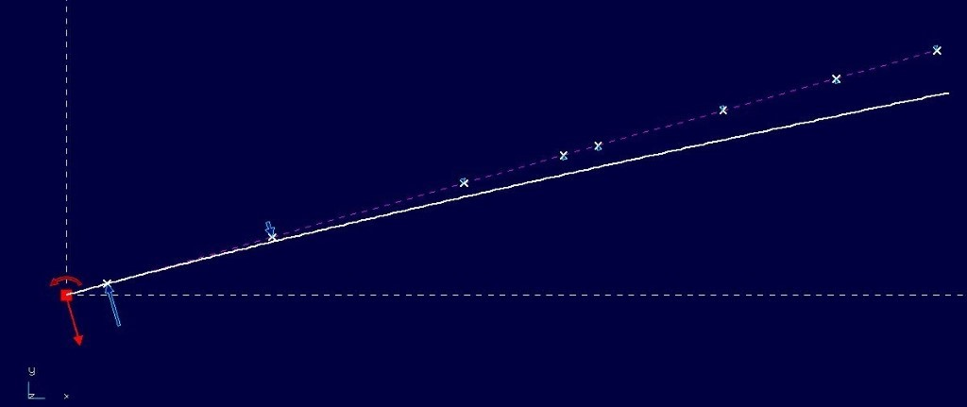
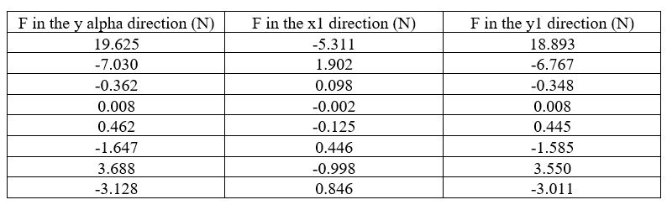
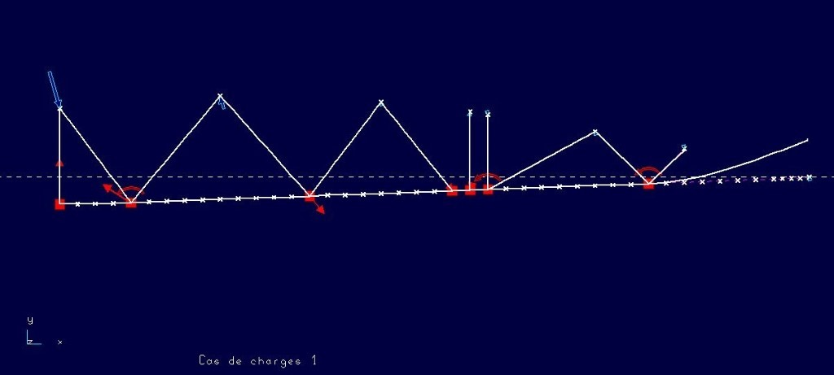
Upper beam:
Rest of the wing rib:

Slide 15
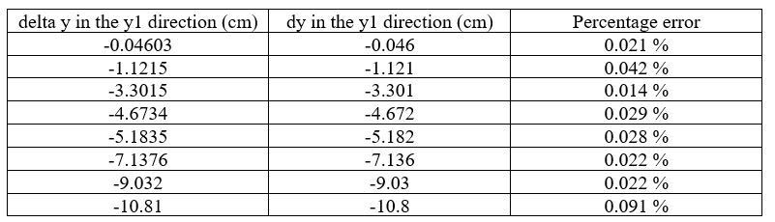
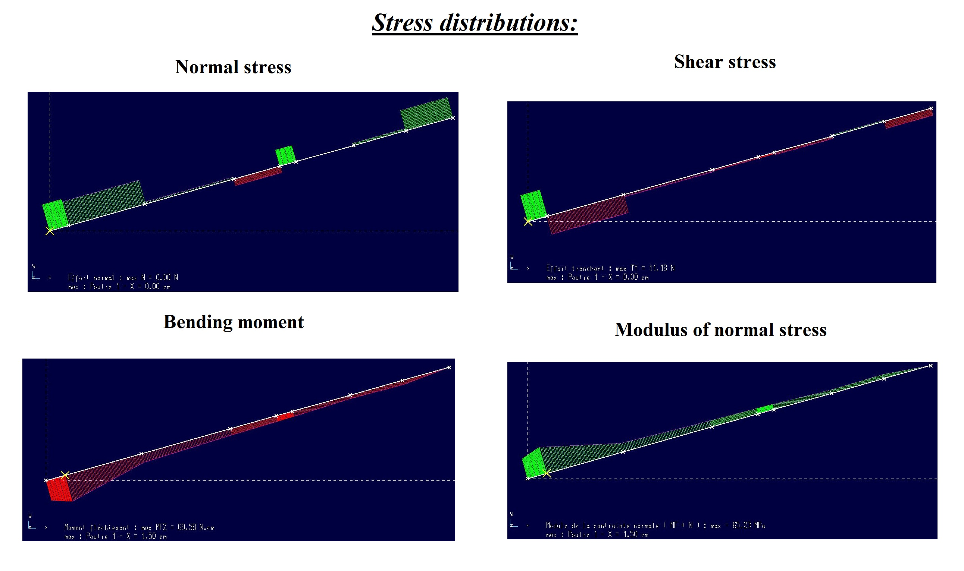
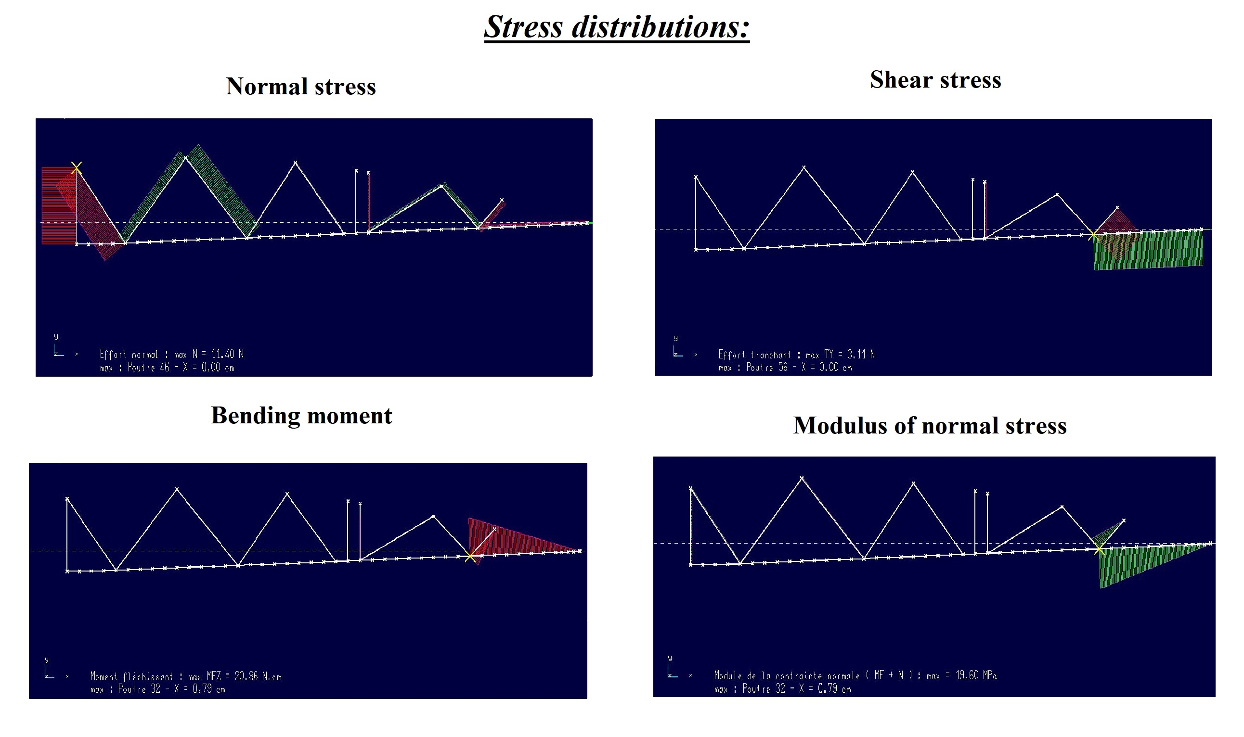
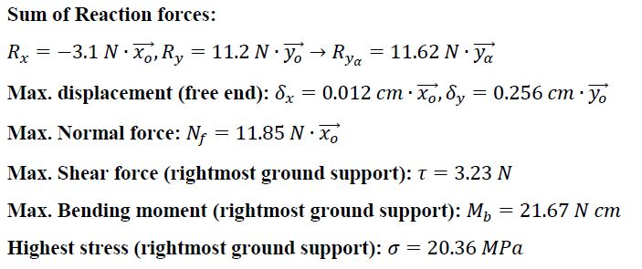
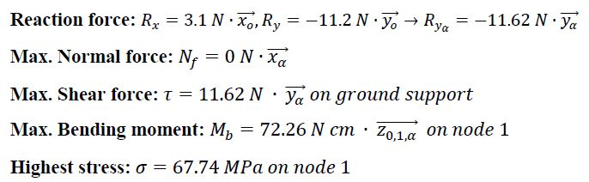
Results
Displacement on upper beam:
Average percentage error: 0.034%
Largest error: 0.098 mm
Upper beam:
Rest of wing rib:

Slide 16
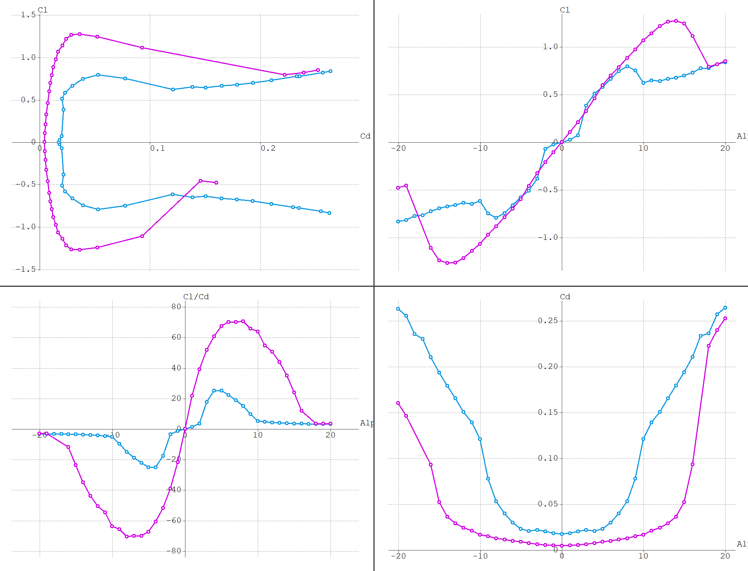
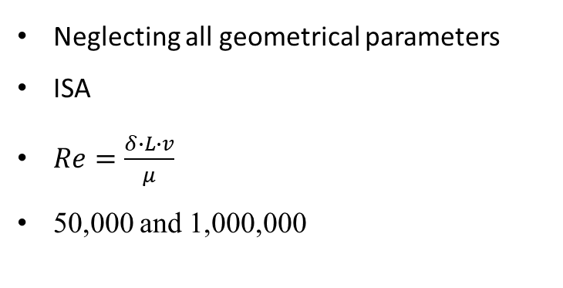
Standard NACA 0010 aerodynamic analysis
Neglecting all geometrical parameters
ISA
$Re=\frac{δ∙L∙v}{μ}$
50,000 and 1,000,000

Slide 17
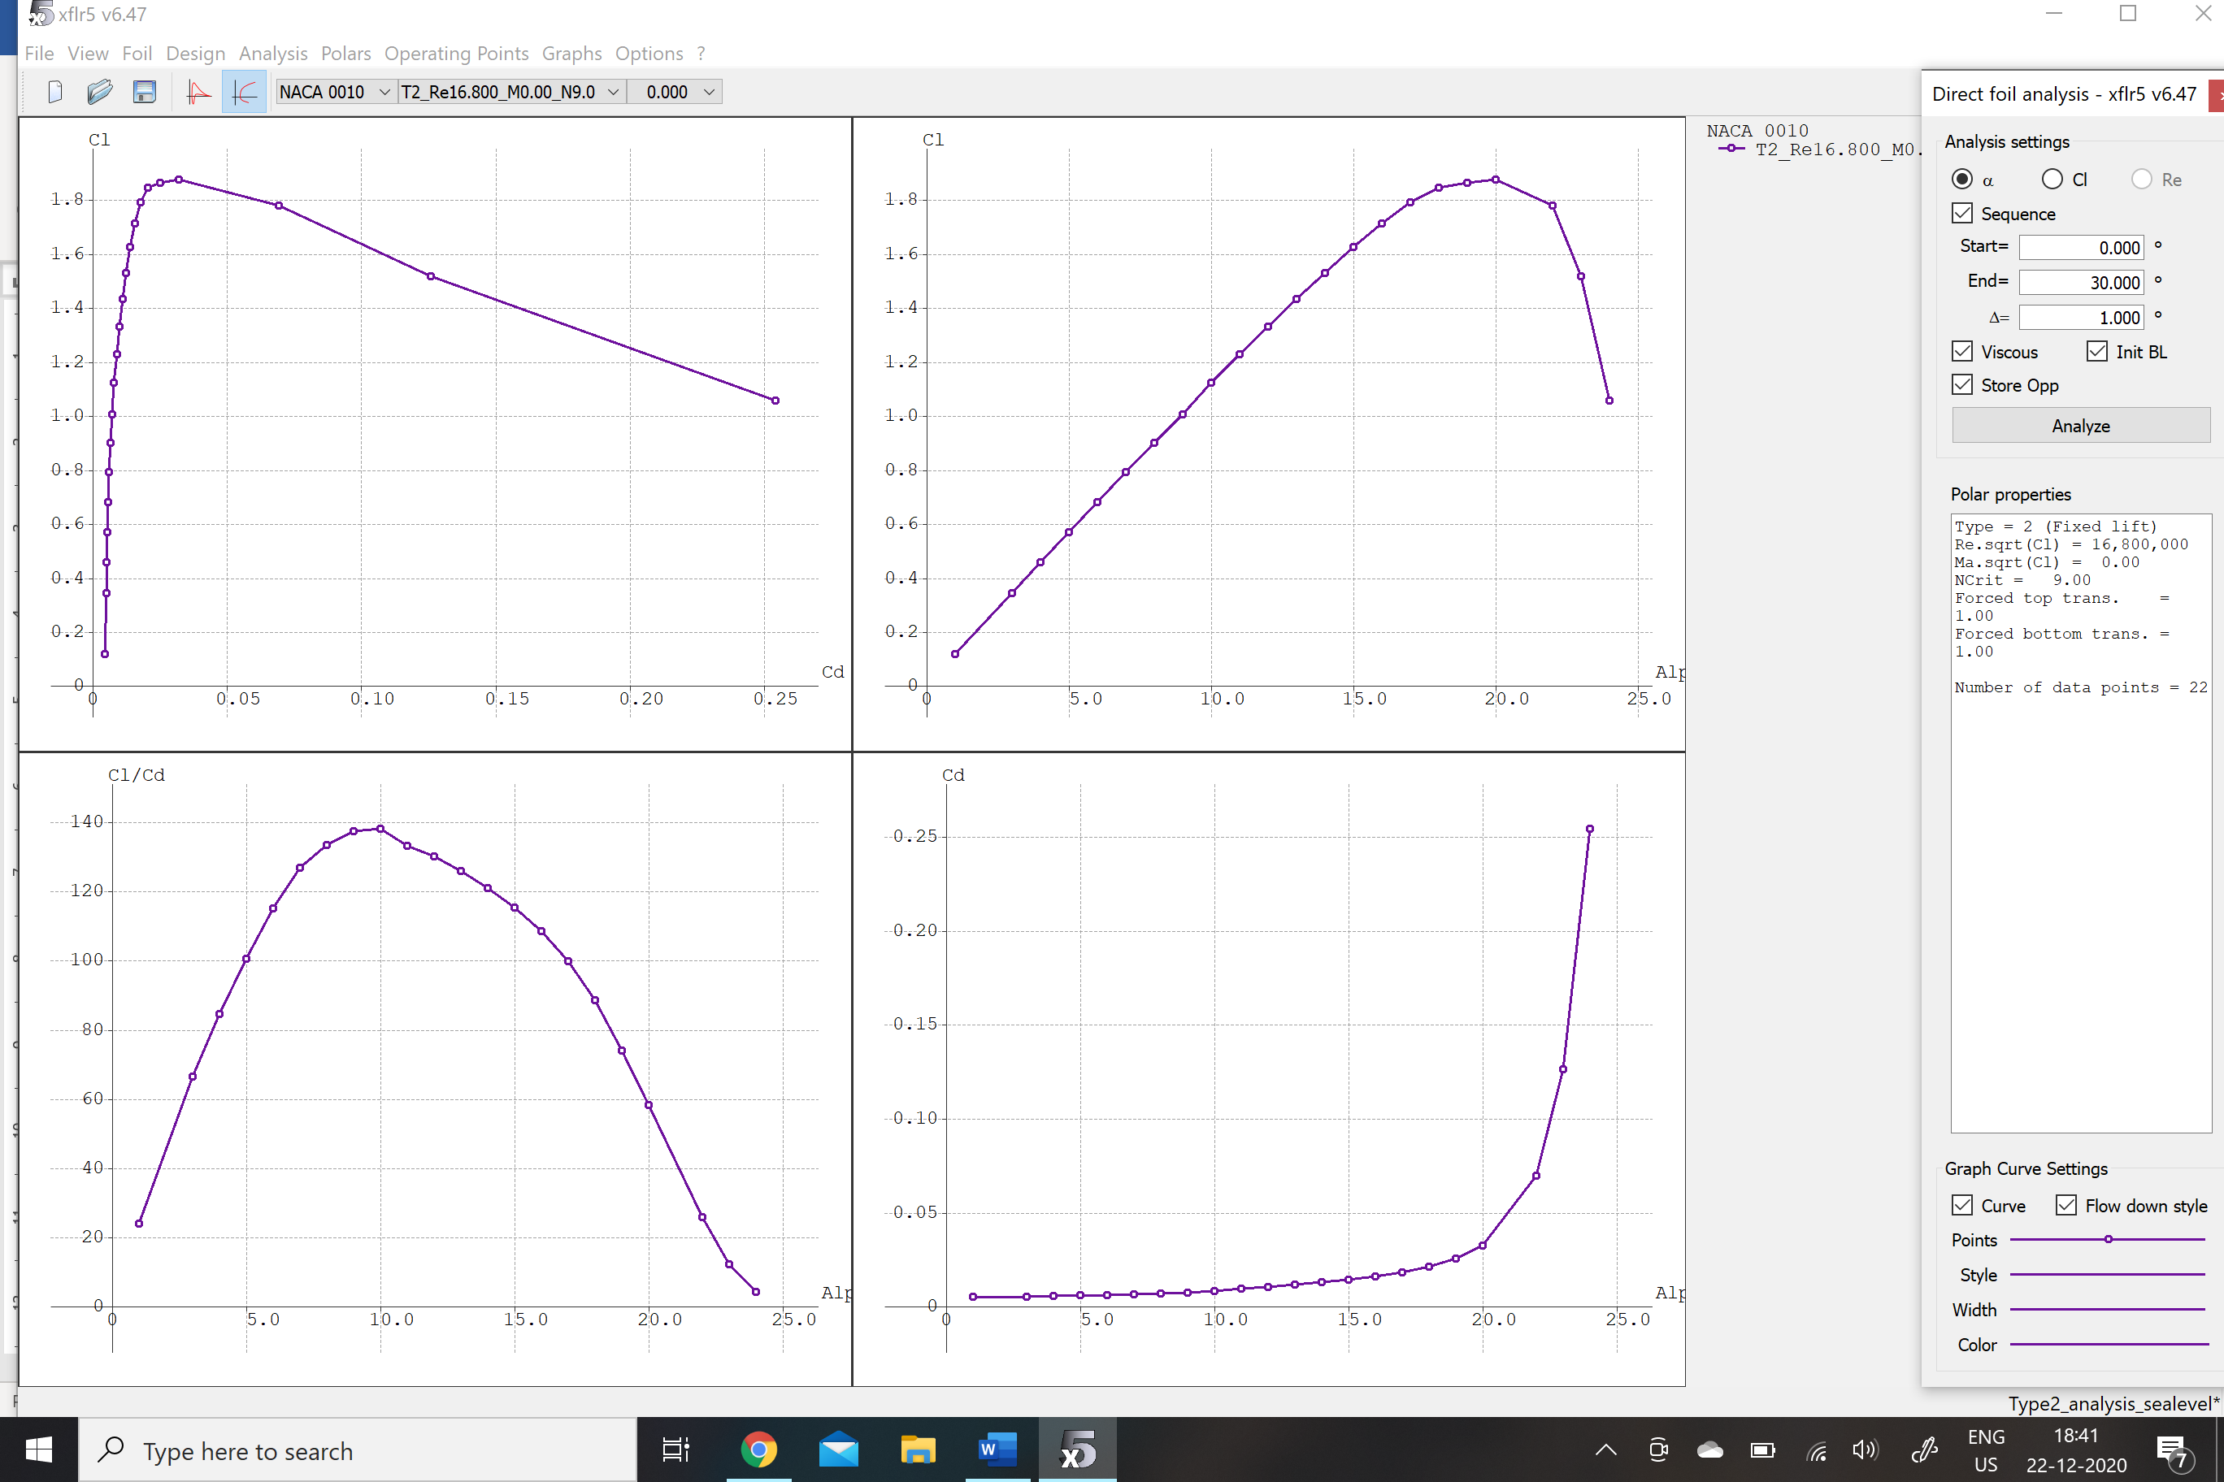
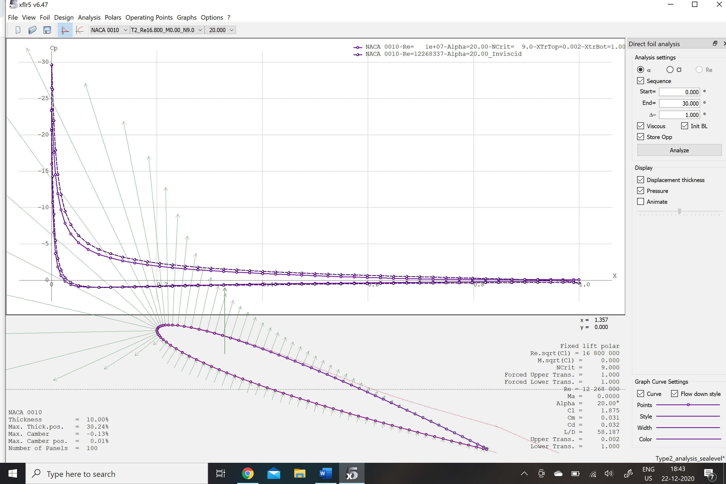
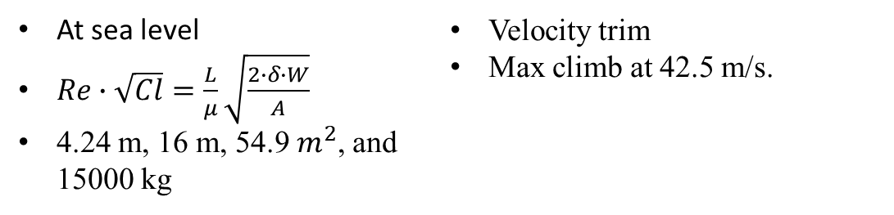
AVRO Canada CF-100 Canuck
At sea level
$Re∙\sqrt{Cl}=\frac{L}{μ}\sqrt{\frac{2∙δ∙W}{A}}$
4.24 m, 16 m, 54.9 $m^{2}$, and 15000 kg
Velocity trim
Max climb at 42.5 m/s.

Slide 18
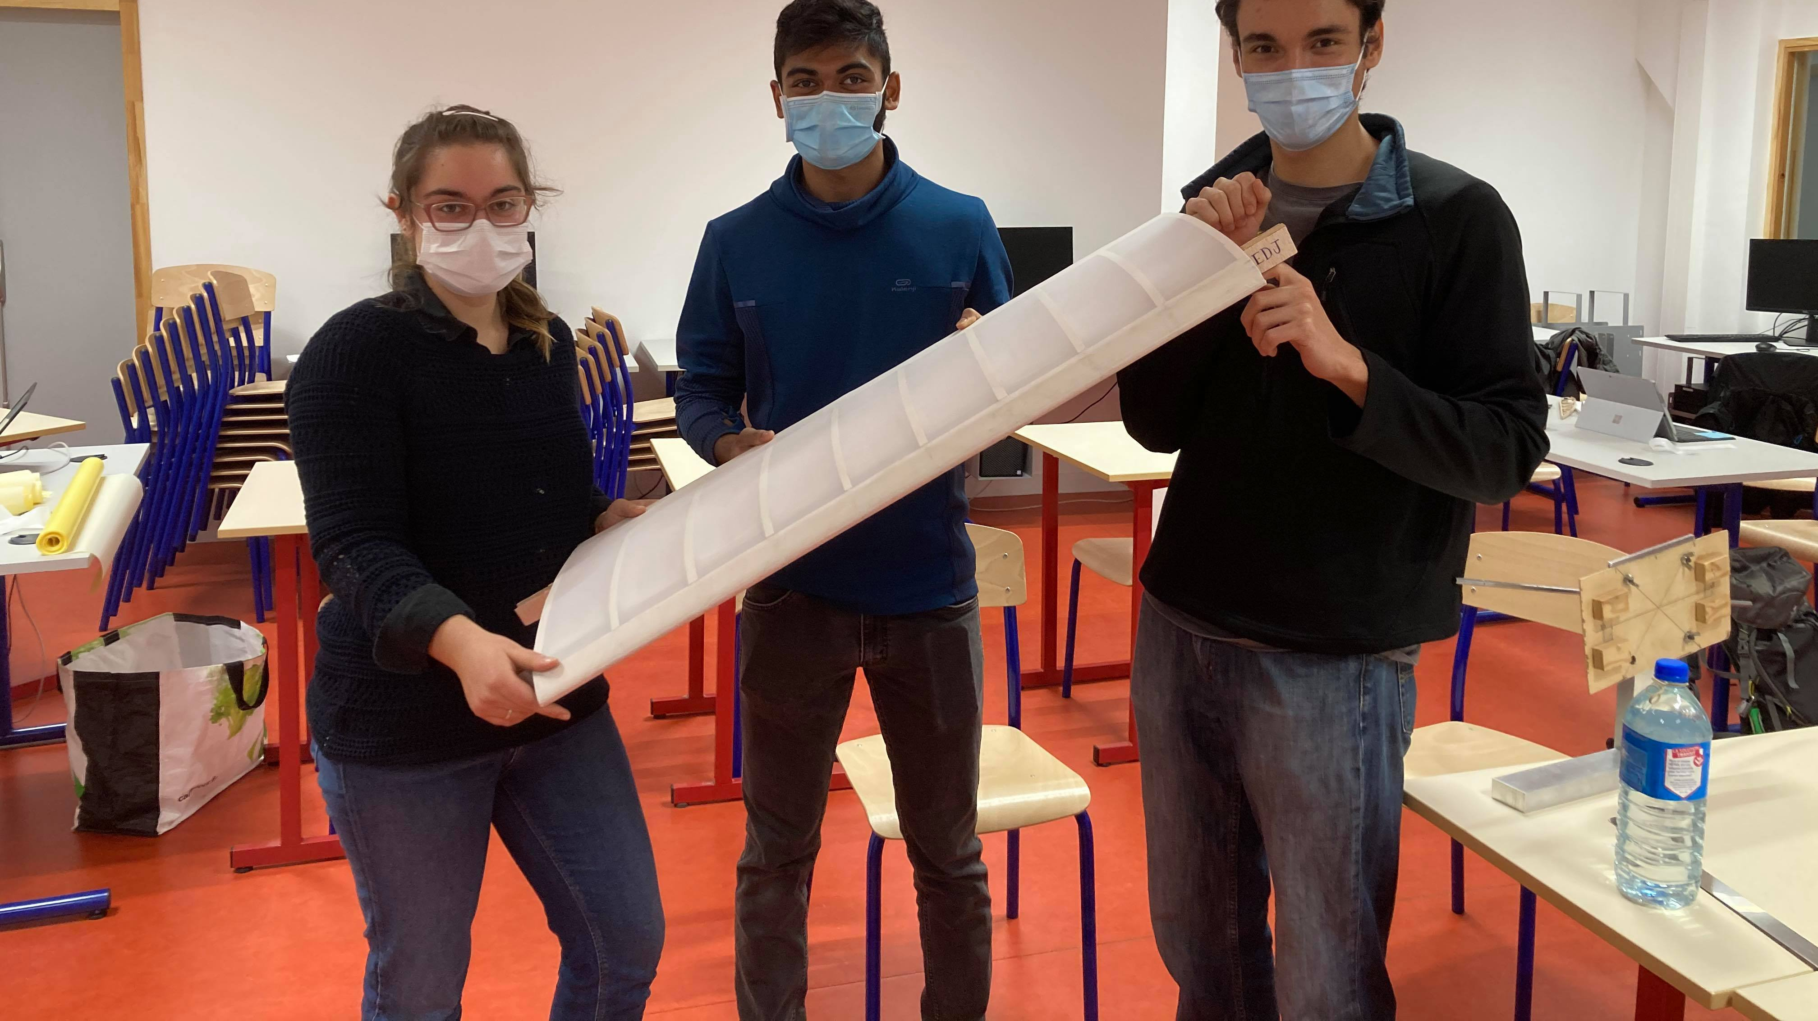
Thank you Questions…?

Slide 19

Torsional Moment of Inertia

